Slide 1
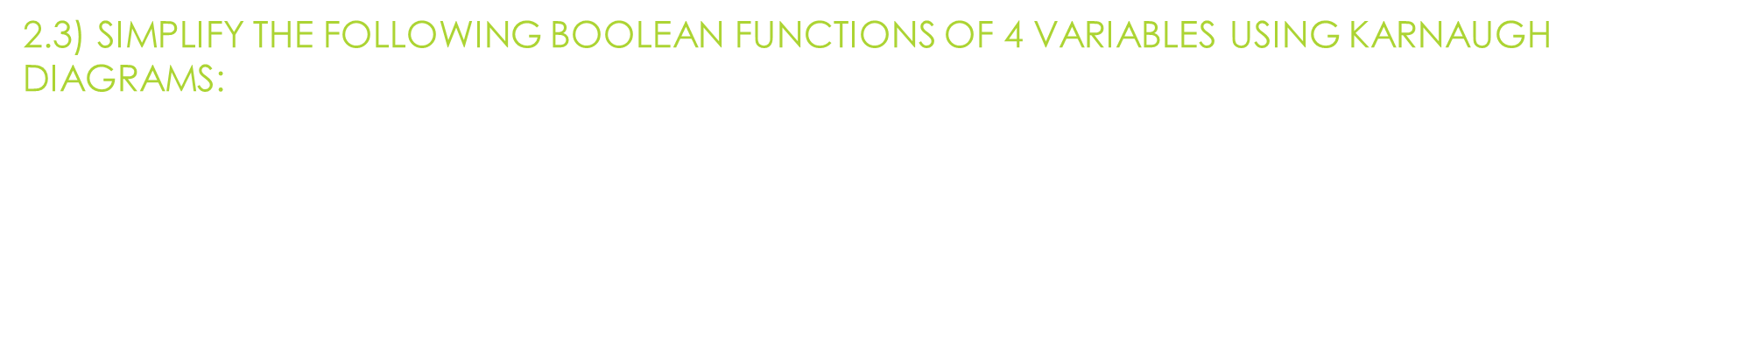
Individual homework
Harangus Dan-Ioan
Group 913
2.3) Simplify the following Boolean functions of 4 variables using Karnaugh diagrams:
$f\left(x_{1},x_{2},x_{3},x_{4}\right)$ = ${\overline{x}}_{1}x_{2}x_{3}x_{4}$ ∨ ${\overline{x}}_{1}x_{2}{\overline{x}}_{3}{\overline{x}}_{4}\text{∨} {\overline{x}}_{1}x_{2}x_{3}{\overline{x}}_{4}$ ∨ $x_{1}{\overline{x}}_{2}x_{3}{\overline{x}}_{4}$ ∨ $x_{1}{\overline{x}}_{2}{\overline{x}}_{3}{\overline{x}}_{4}$ ∨ ${\overline{x}}_{1}{\overline{x}}_{2}{\overline{x}}_{3}{\overline{x}}_{4}$ ∨ $x_{1}{\overline{x}}_{2}x_{3}x_{4}$ ∨ $x_{1}{\overline{x}}_{2}{\overline{x}}_{3}x_{4}$ ∨ ${\overline{x}}_{1}{\overline{x}}_{2}{\overline{x}}_{3}x_{4}$

Slide 2
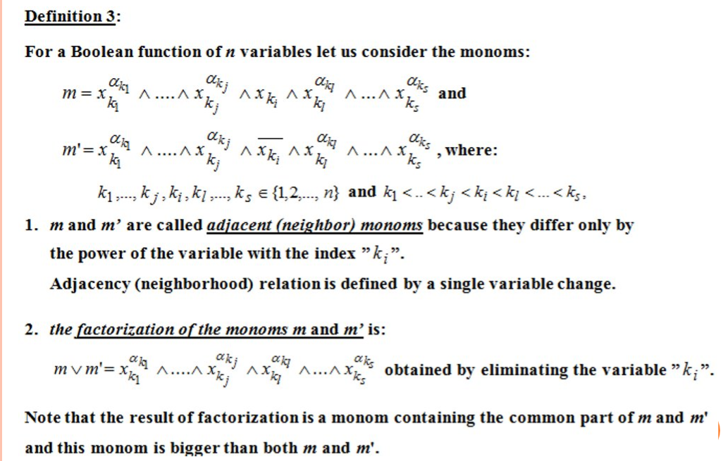
Theoretical results

Slide 3
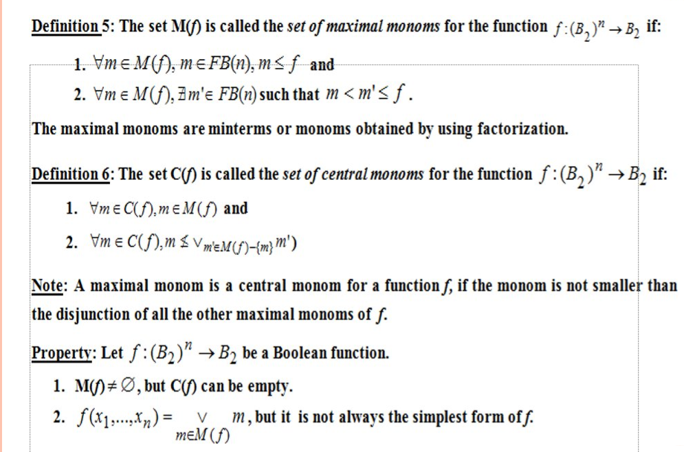
Theoretical results

Slide 4
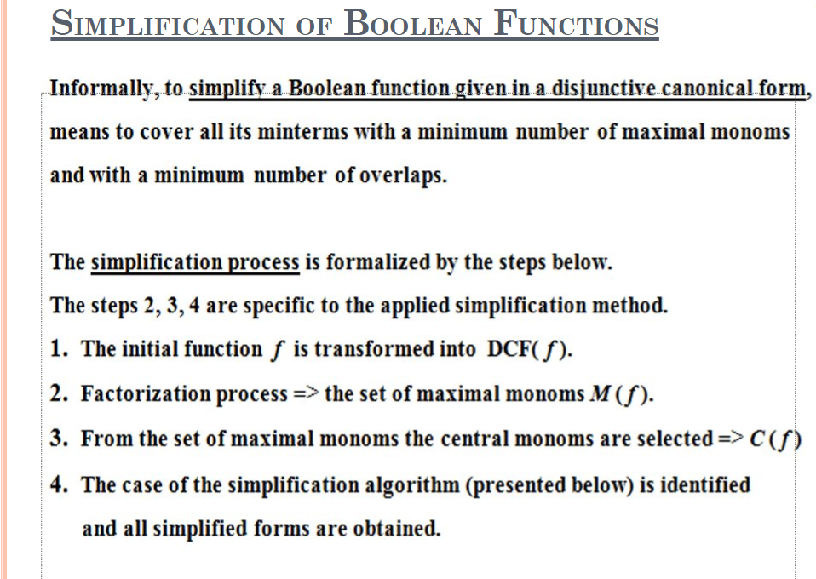
Theoretical results

Slide 5
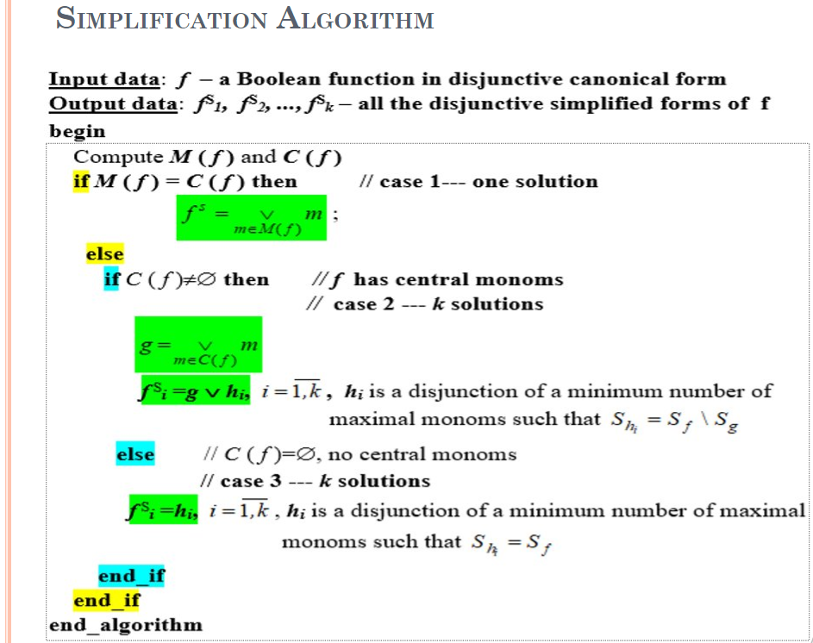
Theoretical results

Slide 6
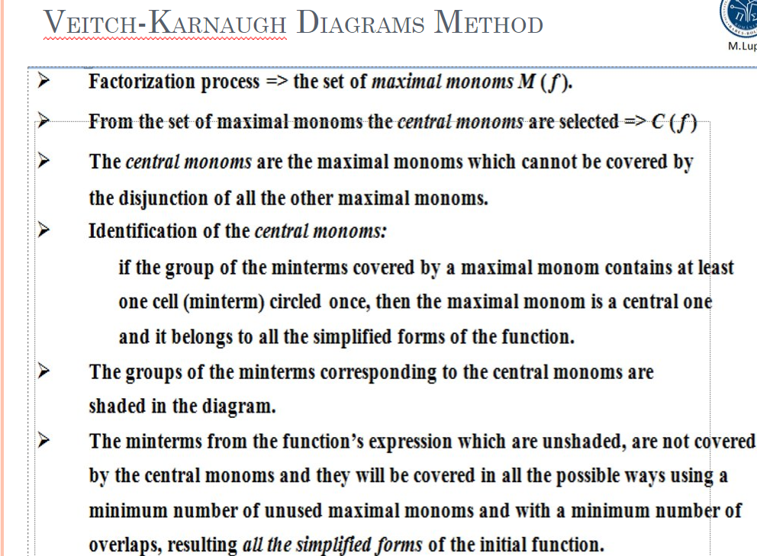
Theoretical results

Slide 7
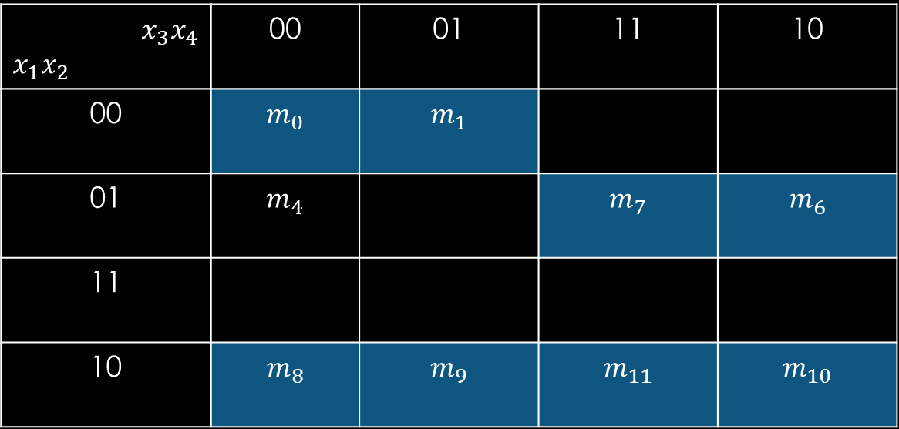


Solution
$f\left(x_{1},x_{2},x_{3},x_{4}\right)$ = ${\overline{x}}_{1}x_{2}x_{3}x_{4}$ ∨ ${\overline{x}}_{1}x_{2}{\overline{x}}_{3}{\overline{x}}_{4} \text{∨} {\overline{x}}_{1}x_{2}x_{3}{\overline{x}}_{4}$ ∨ $x_{1}{\overline{x}}_{2}x_{3}{\overline{x}}_{4}$ ∨ $x_{1}{\overline{x}}_{2}{\overline{x}}_{3}{\overline{x}}_{4}$ ∨ ${\overline{x}}_{1}{\overline{x}}_{2}{\overline{x}}_{3}{\overline{x}}_{4}$ ∨ $x_{1}{\overline{x}}_{2}x_{3}x_{4}$ ∨ $x_{1}{\overline{x}}_{2}{\overline{x}}_{3}x_{4}$ ∨ ${\overline{x}}_{1}{\overline{x}}_{2}{\overline{x}}_{3}x_{4}$ - DCF
= $m_{7}$ ∨ $m_{4}$ ∨ $m_{6}$ ∨ $m_{10}$ ∨ $m_{8}$ ∨ $m_{0}$ ∨ $m_{11}$ ∨ $m_{9}$ ∨ $m_{1}$
Double factorizations
$m_{0}$ ∨ $m_{1}$ ∨ $m_{8}$ ∨ $m_{9}$ = ${\overline{x}}_{2}{\overline{x}}_{3}$ = max1
$m_{8}$ ∨ $m_{9}$ ∨ $m_{11}$ ∨ $m_{10}$ = $x_{1}{\overline{x}}_{2}$ = max2
Simple factorizations
$m_{0}$ ∨ $m_{4}$ = ${\overline{x}}_{1}{\overline{x}}_{3}{\overline{x}}_{4}$ = max3
$m_{7}$ ∨ $m_{6}$ = ${\overline{x}}_{1}x_{2}x_{3}$ = max4
$m_{4}$ ∨ $m_{6}$ = ${\overline{x}}_{1}x_{2}{\overline{x}}_{4}$ = max5
M(f) = {max1, max2, max3, max4, max5}
C(f) = {max1, max2, max4}
max1, max2 and max4 are in C(f) because they contain at least one cell that is only circled once.
$x_{3}x_{4}$ $$x_{1}x_{2}$$ | 00 | 01 | 11 | 10
00 | $m_{0}$ | $$m_{1}$$
01 | $m_{4}$ |  | $m_{7}$ | $$m_{6}$$
11
10 | $$m_{8}$$ | $$m_{9}$$ | $$m_{11}$$ | $$m_{10}$$

Slide 8

Solution
We denote $g\left(x_{1},x_{2},x_{3},x_{4}\right)$ = max1 ∨ max2 ∨ max4
Only $m_{4}$ is not covered by $g$ and we can cover it in two ways (with max3 and max5).
Therefore, there are two disjunctive simplified forms of f:
$f_{1}^{DS}$ = g ∨ max2 = max1 ∨ max2 ∨ max4 ∨ max3
= ${\overline{x}}_{2}{\overline{x}}_{3}$ ∨ $x_{1}{\overline{x}}_{2}$∨ ${\overline{x}}_{1}x_{2}x_{3}$ ∨ ${\overline{x}}_{1}{\overline{x}}_{3}{\overline{x}}_{4}$
$f_{2}^{DS}$ = g ∨ max2 = max1 ∨ max2 ∨ max4 ∨ max5
= ${\overline{x}}_{2}{\overline{x}}_{3}$ ∨ $x_{1}{\overline{x}}_{2}$∨ ${\overline{x}}_{1}x_{2}x_{3}$ ∨ ${\overline{x}}_{1}x_{2}{\overline{x}}_{4}$

